Slide 1

PENDRAGON SUPERFOODS UK
International Buisness (DSBW 4)
Matthias Ewald
Adrian Harms

Slide 2
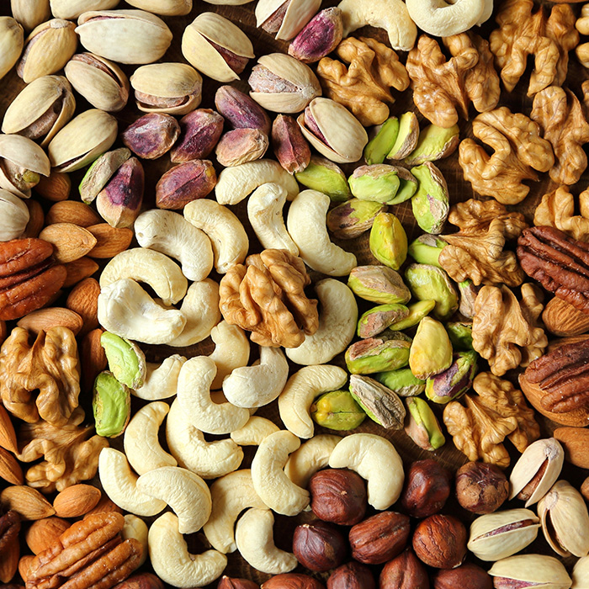
Agenda
Pendragon Snacks
PESTEL Analysis
Market Entry Strategy
Conclusion

Slide 3
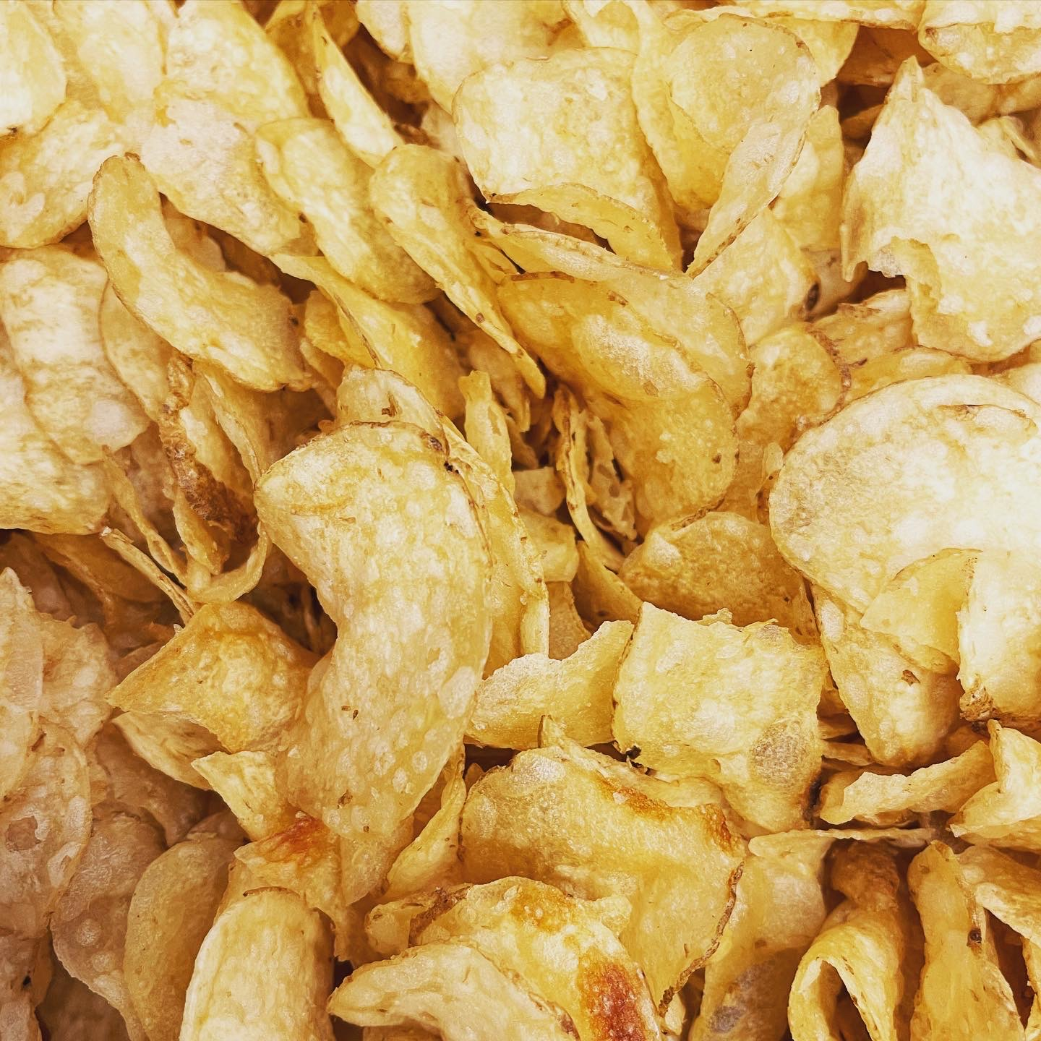
Pendragon Snacks
New Zealand based producer and marketer of healthy snack food
Product line consists of low fat, low sodium crisps and flavoured nuts
Healthy snacks that are still packed with flavour
Target customers are health conscious, middle to upper-class consumers
Premium price of NZD 4.99 per 175g pack for crisps and NZD 4.49 for a 130g pack of flavoured nuts

Slide 4
PESTEL Analysis
FOR PENDRAGON SUPERFOODS
IN UK

Slide 5

Political
UK as a country
Political stability index: 0.54 (-2.5 low, 2.5 high)
High competition food market
Trade policies and agreements:
No FTA between Australia and the UK
Taxes variate between the various products

Slide 6

Economic
Consumer purchasing power:
Disposable income: £2,156/month
Average spending on food: £4,124/year
Economic stability:
GDP per capita: 45,294.8 2022 46,371.45 in 2023
Inflation: 7,9%

Slide 7

Social
Health consciousness:
Growing trend of health consciousness
High demand for low-fat, low-sodium snacks
Cultural preferences:
Trend to healthier snacks
Especially in the younger generations

Slide 8
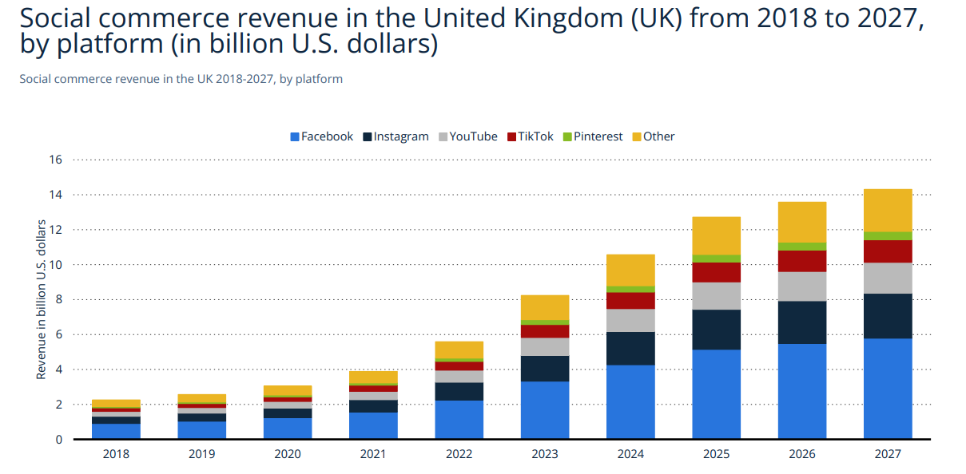
Social Channels
28.06.2023

Slide 9

Technological
Digital adoption:
UK Food & Personal Care eCommerce Market
Projected to reach $38,817.6 million in 2023
Expected growth rate: 11,6%
Product innovation:
Monitoring technological advancements
Develop innovative products

Slide 10

Environmental
Sustainable sourcing:
Growing focus on sustainability
Source ingredients from sustainable and ethical sources
Packaging and waste management
Implement eco-friendly packaging
Enhance the brand image to be known for sustainability

Slide 11

Legal
Labeling:
Name, “best before”, warnings, weight, ingredients, country or place of origin, lot number, storage conditions and instruction for use (if necessary)
Intellectual property protection:
Recipes are not patentable
Trade secrets are a save way to protect the recipe

Slide 12
MARKET ENTRY STRATEGY
FOR PENDRAGON SUPERFOODS
IN UK

Slide 13
Market entry process
Legal
Acquire all necessary food safety and legal requirements
Budget
Decide budget and explore funding opportunities
Price
Determine the right price for the products
Trends
Stay aware of new diet trends and create a unique selling proposition
Marketing
Create a buzz around the food product through strategic marketing
Partnerships
Partner with leading online grocery delivery stores
28.06.2023

Slide 14

Food safety and legal requirements
Register business with local authority
FSA responsible for food safety and hygiene in the UK
Non-registration can lead to fines and/ or imprisonment
Local authority inspections to analyse product quality

Slide 15

Budget and funding opportunities
Expenses associated with food production
Raw materials, logistics, storage, distribution, and marketing
Importance of balancing costs and preventing fund problems
Partnering within budget for raw materials, storage, and distribution
Government grants for new businesses, inquire with local authorities

Slide 16

Determine right price for products
Two prices: distributors/supermarkets and customers (MSRP)
Consider various costs for determining MSRP
Cost of goods
Production costs (ingredients, processing, and packaging fees)
Transport and storage costs (Custom duties)
Distributor’s and retailer’s margin
Highlight unique ingredients and benefits to justify pricing compared to competitors

Slide 17

Pay attention to new diet trends
Growing vegan and health-conscious trends
Utilize social media listening and research papers
Determine product fit in new diet trends
Create a unique selling proposition (USP)
Boost your protein intake with Pendragon Snacks, it’s healthy, vegan and full of taste!

Slide 18
Veganism in UK
Source: https://www.statista.com/topics/7297/veganism-in-the-united-kingdom/#topicOverview
28.06.2023

Slide 19

Create buzz around products
Importance of building interest and trust
Offer free samples and tell a compelling product story
Highlight desired attributes (e.g., healthy and full of taste)
Promote product certification on social media
Collaborate with niche influencers for marketing (e.g. Instagram/ TikTok)

Slide 20

Partner with online grocery stores
Rise of online food purchasing
Benefits of partnering with online grocery delivery stores
Increased orders through established shopper base
Identify relevant online stores and pitch our merchandise (e.g. TESCO)
Utilize tools to find contact information of the concerned authority

Slide 21
Conclusion
FOR PENDRAGON SUPERFOODS
IN UK

Slide 22
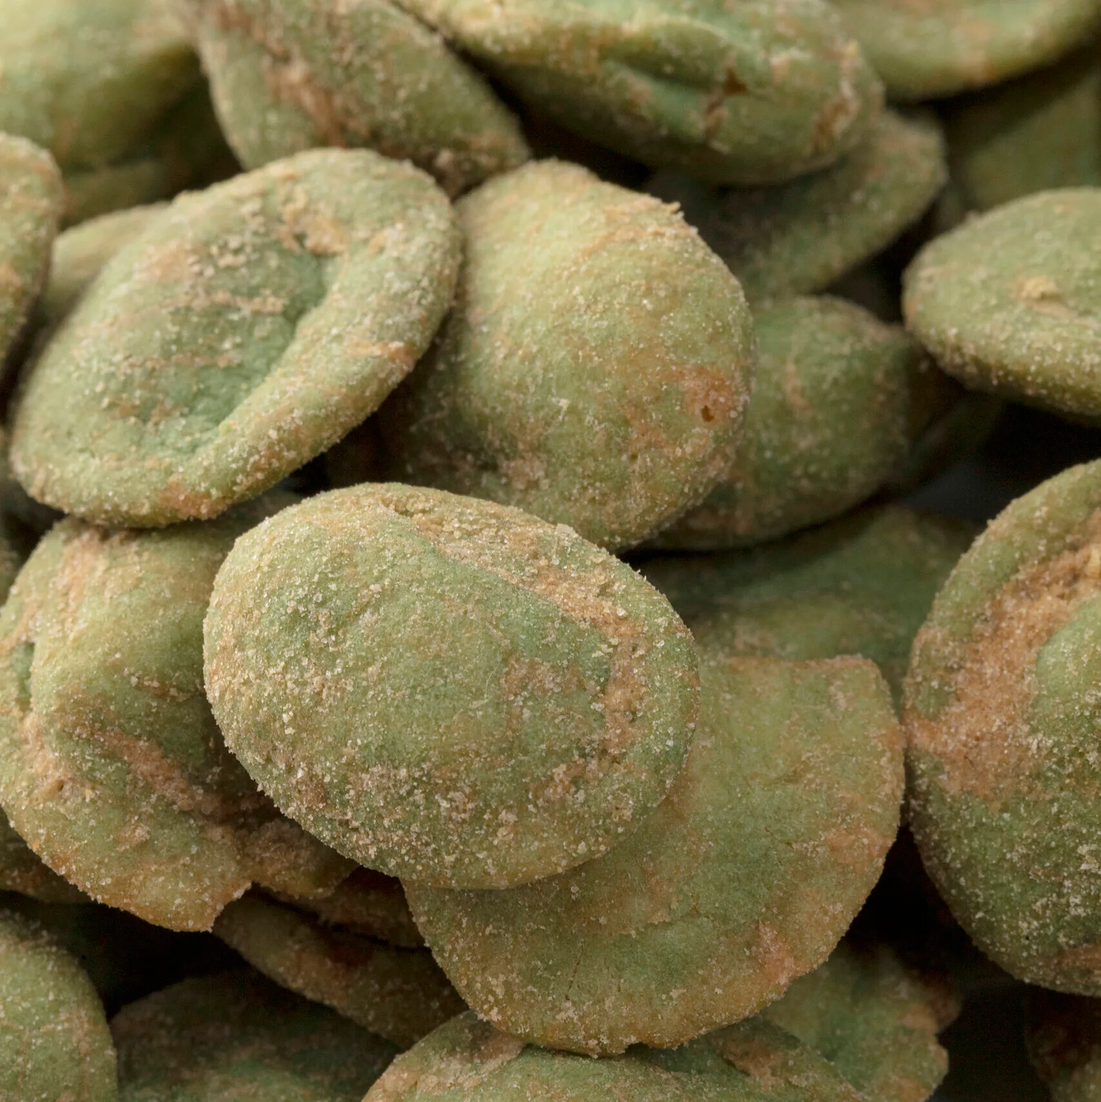
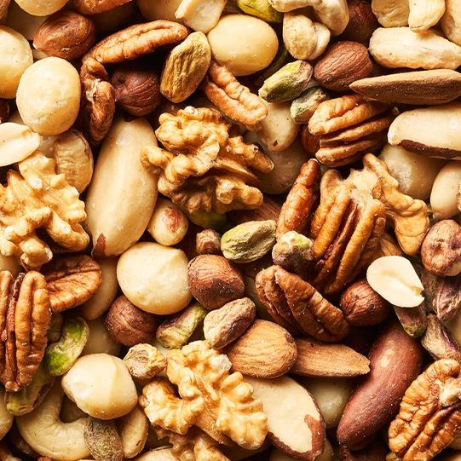
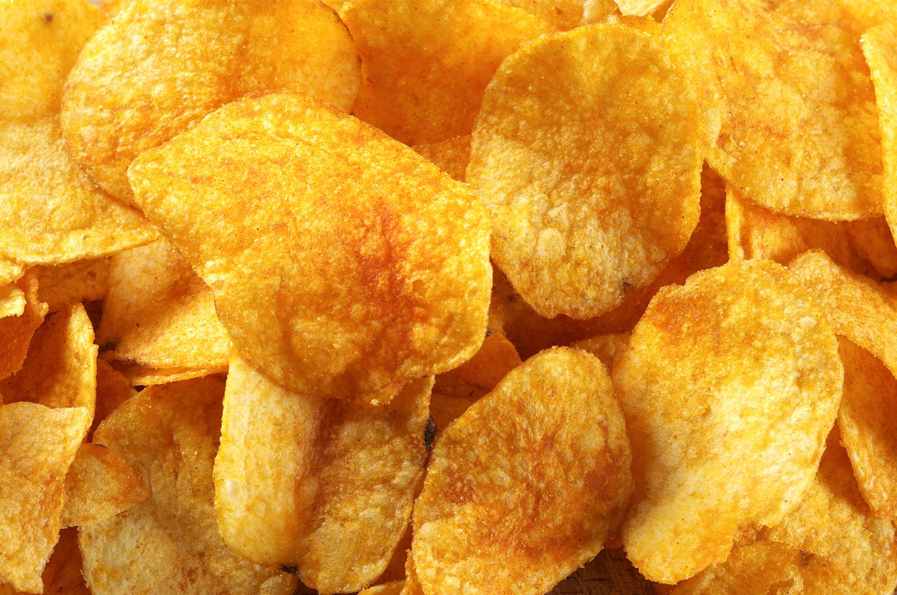
Conclusion
Pendragon is well-positioned to enter the UK market
Be aware of eco-friendly packaging/ sourcing and correct labelling
Focus on product differentiation and premium quality ► veganism
Leveraging of online retailing and product promotion

Slide 23
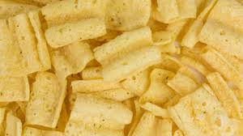
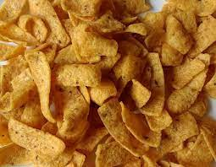
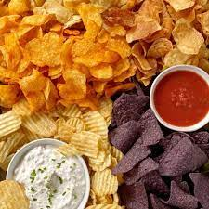
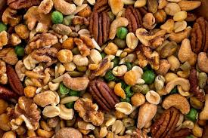
Thank you!
Matthias Ewald
Adrian Harms

Slide 24
Sources
https://www.gov.uk/food-business-registration
https://entrepreneurhandbook.co.uk/grants-loans/
https://www.bdc.ca/en/articles-tools/marketing-sales-export/export/how-enter-foreign-market
https://www.nimblefins.co.uk/average-uk-household-cost-food
https://blog.moneyfarm.com/en/financial-planning/average-disposable-income-in-the-uk-per-month/#:~:text=According%20to%20the%20UK%20Government,housing%20cost%20has%20been%20deducted.
https://www.ons.gov.uk/economy/inflationandpriceindices
https://www.reddie.co.uk/2016/11/29/food-for-thought-patents-protecting-food-related-inventions/
https://www.gov.uk/food-labelling-and-packaging/food-labelling-what-you-must-show
28.06.2023

